Slide 1
In the Name of God
Tailored Hydration With Lactated Ringer’s Solution for Postendoscopic Retrograde Cholangiopancreatography Pancreatitis Prevention: A Randomized Controlled Trial
Peresented By:
Dr. Reyhane Ghanbari
January 2025

Slide 2
Table of Content
INTRODUCTION
METHODS
RESULTS
DISCUSSION
CONCLUSION
Study Highlights

Slide 3
INTRODUCTION
A common complication of endoscopic retrograde cholangiopancreatography (ERCP) is post-ERCP pancreatitis (PEP). Most PEP ranges from mild to moderate severity. However, 0.5% of these patients manifest with severe condition, requiring extended hospital stays and intensive care unit care (1).
Numerous studies have highlighted preventive strategies against PEP. Rectal administration of nonsteroidal antiinflammatory drugs (NSAIDs) has become a standard preventive measure (2,3). However, renal insufficiency, active peptic ulcer disease, and NSAID allergy are major contraindications to NSAID use. In addition, rectal NSAIDs are not commercially available in some countries

Slide 4
INTRODUCTION
Pancreatic stenting is another method for PEP prophylaxis. It is recommended in patients with predisposing conditions to PEP, such as difficult cannulation, inadvertent pancreatic guidewire insertion, and ampullectomy (2,3). However, PEP increases if selective pancreatic duct (PD) cannulation is difficult or if pancreatic stenting fails (4).
Aggressive hydration with lactated Ringer’s solution (LRS) has also been shown to prevent PEP development (2,3). However, pulmonary or peripheral edema may occur due to volume overload. Another concern is the lengthy administration often requiring admission, despite many ERCP procedures being performed on an outpatient basis with a short observation period (5,6). Moreover, the optimal timing and hydration volume have not been defined

Slide 5
B) METHODS
Study design
Participants
Randomization and masking
Procedures
Outcomes
Statistical analysis

Slide 6
B) METHODS
Study design
- A prospective, multicenter, double-blind randomized controlled trial (RCT) was conducted on patients who were subjected to ERCP at 3 tertiary referral centers in South Korea. The Institutional Review Boards of the participating hospitals approved the study protocol (Institutional Review Board No. CNUH-2018-080).
- This study was conducted in accordance to the principles of the Declaration of Helsinki.
- This trial was registered at the ClinicalTrials.gov (NCT03561441) and the Clinical Research Information Service (KCT0003196).

Slide 7
B) METHODS
Participants
- Patients older than 20 years who underwent first-time ERCP were recruited.
- The exclusion criteria were as follows:
refusal to participate in the study,
younger than 20 years,
older than 80 years,
unable to give informed consent,
pregnancy,
end-stage renal disease (estimated glomerular filtration rate, 30 mL/min/ 1.73 m2 ),
advanced chronic obstructive pulmonary disease requiring home oxygen,
severe heart failure (New York Heart Association classification $II),
ongoing sepsis,
acute or chronic pancreatitis,
signs of volume overload,
hyponatremia or hypernatremia,
hyperkalemia,
and prior endoscopic sphincterotomy or papillary balloon dilatation.

Slide 8
B) METHODS
Randomization and masking
- Eligible patients were randomly assigned to 2 groups before ERCP after enrollment. Patients underwent random allocation by the study coordinator in a 1:1 ratio to receive either tailored standard hydration (TSH) or tailored aggressive hydration (TAH).

Slide 9
B) METHODS
Procedures
- ERCP was performed under conscious sedation with midazolam, propofol, and pethidine using a side-viewing duodenoscope (TJF260V; Olympus, Tokyo, Japan). All ERCP interventions were performed by expert endoscopists.
- A standard cannulation technique was used. Precut access was achieved for salvage if wire-guided cannulation was unsuccessful within 5 minutes or with >5 attempts of contact with the papilla. Pancreatic stent placement was decided by endoscopists, mostly performed when a PD guidewire was inadvertently inserted more than twice, with double-guidewire cannulation, PD injection, or endoscopic papillectomy. For pancreatic stenting, 5 Fr 3–4 cm plastic stents were used.

Slide 10
B) METHODS
Procedures
- Patients in the TSH group received intravenous LRS at a rate of 1.5 mL/kg/hr during ERCP and for 4–6 hours after the intervention.
- Patients in the TAH group received intravenous LRS at a rate of 3 mL/kg/hr during ERCP, 20 mL/kg bolus after ERCP, and 3 mL/kg/hr for 4–6 hours after the procedure.
- In both groups, serum amylase levels and epigastric pain using visual analog pain scores (scale of 0–10) were assessed 4 hours post-ERCP if pancreatic stenting was not performed and 6 hours post-ERCP if it was performed. If elevated serum amylase levels (.1.5 times the upper normal limit [UNL]) and epigastric pain were not detected 4–6 hours post-ERCP, intravenous hydration was discontinued. If either one of the mentioned factors was observed, hydration was continued at the original rate for a total time of 8 hours after ERCP.

Slide 11
B) METHODS
Procedures
- Epigastric pain was reassessed 8 hours post-ERCP (8 hours pain). If 8 hours pain was absent, hydration was terminated. If it was present and the amylase level measured 4 or 6 hours postERCP was $3 times the UNL, PEP was suspected and aggressive hydration (3 mL/kg/hr) was performed until 24 hours after ERCP
- If 8 hours pain was present and the serum amylase level measured at 4 or 6 hours was, 3 times the UNL, the serum amylase level was reevaluated 8 hours post-ERCP. If the serum amylase level at 8 hours post-ERCP was $3 times the UNL, PEP was suspected, and aggressive hydration (3 mL/kg/hr) was used. If 8 hours-pain was present, but each serum amylase level estimated at 4, 6, or 8 hours after ERCP was, 3 times the UNL, the fluid administration rate was titrated to 1.5 mL/kg/hr from 8 hours to 24 hours post-ERCP. All patients were admitted to the hospital, and epigastric pain and serum amylase levels were assessed at 24 hours after ERCP (Figure 3).

Slide 12
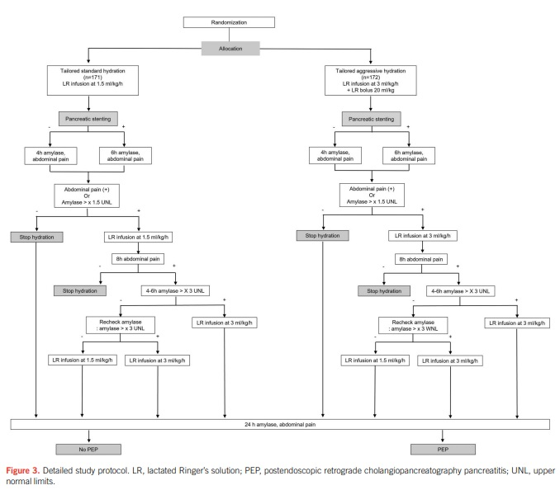

Slide 13
B) METHODS
Outcomes
- The primary outcome was the incidence of PEP, defined as the combination of persistent epigastric pain and elevation of serum amylase $3 times the UNL 24 hours after ERCP, requiring prolonged hospitalization for $48 hours (2).
- Secondary outcomes were as follows:
(i) pancreatitis severity, defined by the revised Atlanta classification (7);
(ii) incidence of post-ERCP hyperamylasemia;
(iii) epigastric pain without hyperamylasemia;
(iv) volume overload, characterized by peripheral edema or dyspnea secondary
to pulmonary edema;
(v) incidence of other ERCP-related complications, such as bleeding or perforation

Slide 14
B) METHODS
Outcomes
- The number of patients in which fluid discontinuation was used 4–6 hours post-ERCP, total fluid volumes during the 24 hour period, hospital stays, and death within 2 weeks after ERCP were also evaluated. Other ERCP-related adverse events included cholangitis, bleeding, perforation, and cholecystitis were defined as per the European Society of Gastrointestinal Endoscopy guideline (2, 8, 9). The outcomes were assessed centrally and independently.
- A high risk of PEP was defined as the presence of 1 major or 2 minor risk factors. Major risk factors included female sex, sphincter of Oddi dysfunction, $8 cannulation attempts or cannulation for $10 minutes, PD injection, and $2 PD cannulation. Minor risk factors were age, 40 years recurrent acute pancreatitis, serum total bilirubin 1.0 mg/dL, precut access, and endoscopic papillary dilatation (2).

Slide 15
B) METHODS
Statistical analysis
- Assuming that the incidence of PEP was 11% in the TSH group and 3% in the TAH group, a minimum sample size of 156 patients in each arm was determined to attain a power of 0–8 with a type II error of 0.2. With an estimated 10% dropout rate, a target of 172 patients in each arm was set.
- Baseline characteristics were described as numbers or rates and 2-sided 95% confidence intervals (CIs) for categorical variables. Continuous normally distributed variables were presented as mean and SD and analyzed using Student t test, whereas the median and interquartile range were used to those with nonparametric distribution.

Slide 16
B) METHODS
Statistical analysis
- Analyses were conducted using an intention-to-treat analysis (ITT) and per-protocol analysis (PP). To compare categorical variables, Pearson x2 test or Fisher exact test was used. The primary and secondary outcomes were assessed using the Fisher exact test and reflected as relative risk (RR) and 95% CI. Statistical significance was set at a P value < 0.05.
- Subgroup assessments of fluid continuation status 4–6 hours post-ERCP and risk factors for PEP were performed using Pearson x2 test, Fisher exact test, or Student t test, as appropriate. For the former subgroup analysis, a P value < 0.025 was considered statistically significant (10). The IBM-SPSS software version 25.0 (IBM, Armonk, NY) was used for all statistical analyses.

Slide 17
C) RESULTS
Patient characteristics
Primary outcomes
Secondary outcomes
Subgroup analysis

Slide 18
C) RESULTS
Patient characteristics
- Between May 2018 and January 2022, 350 patients were assessed for eligibility, with 344 finally included and randomized to the TSH (n=171) and TAH groups (n=173) (Figure 1).
- One patient in the TAH group withdrew informed consent and was eliminated from the ITT analysis. Another patient in the TAH group with chronic pancreatitis observed in the abdominal computed tomography was excluded from the per-protocol analysis.
- The baseline characteristics were similar in the 2 groups except for the indication of ERCP (Table 1). More patients in the TAH group (141/172, 82%) had choledocholithiasis than those in the TSH group (117/171, 68.4%, P=0.01), and more patients in the TSH group (36/171, 21.1%) had malignant biliary obstruction compared with the TAH group (20/172, 11.6%, P=0.02).

Slide 20
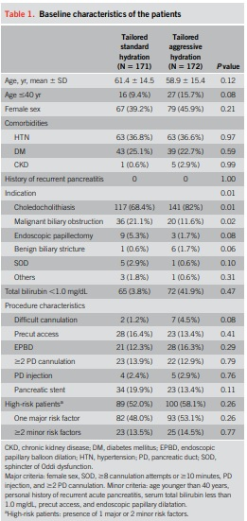

Slide 21
C) RESULTS
Primary outcomes
- Overall, PEP occurred in 22 patients (6.4%). PEP developed less frequently in the TAH group vis-a-vis the TSH group through ITT analysis: 16 patients (9.4%, 95% CI 5.3%–15.2%) in the TSH group vs 6 (3.5%, 95% CI 1.3%–7.6%) in the TAH group, with an RR of 0.37 (95% CI 0.15–0.93, P= 0.03) (Figure 2).

Slide 22
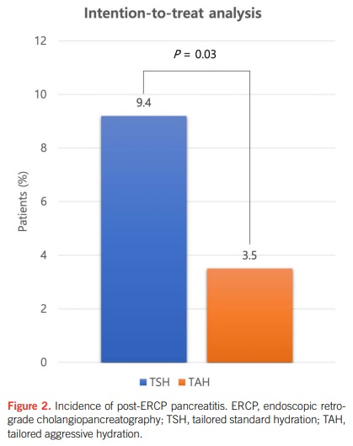

Slide 23
C) RESULTS
Secondary outcomes
- PEP severity did not significantly differ between the 2 groups. Cases of severe pancreatitis were not observed.
- In the ITT analysis, no significant difference was observed between the 2 study groups regarding post-ERCP pain and amylase levels >1.5 times UNL at 4–6 hours. Hydration was discontinued 4–6 hours post-ERCP in 88 patients (51.5%) in the TSH group and 88 patients (51.2%) in the TAH group, with no statistical difference.

Slide 24
C) RESULTS
Secondary outcomes
- In the ITT analysis, post-ERCP pain at 24 hours occurred less often in the TAH group (15.7%, 95% CI 10.3%–22.8%; 27/172) vis-a-vis the TSH group (26.3%, 95% CI 19.2% –35.2%; 45/171), resulting in an RR of 0.60 (95% CI 0.39–0.91, P=0.02). No significant difference was observed in the post-ERCP hyperamylasemia, post-ERCP asymptomatic hyperamylasemia, post-ERCP pain without hyperamylasemia at 24 hours and median hospital days between the 2 groups.
- The mean total volume of fluid administered during the 24 hours period in the study cohort was 1,978.1 ± 1,372 mL. A greater volume of fluid was prescribed during the 24 hours period in the TAH group (2,814.6 ± 1,086.3 mL) than the TSH group (1,136.7 ± 1,086.2 mL, P < 0.001).

Slide 25
C) RESULTS
Secondary outcomes
- Complications induced by volume overload did not significantly differ between the TSH and TAH groups. Only 1 patient (0.6%) in the TSH group developed dyspnea but recovered with oxygen and diuretic therapy. The incidence of bleeding was 5 (1.5%) and did not differ significantly between the 2 groups. In all cases of bleeding, endoscopic hemostasis was successful. One patient (0.6%) in the TSH group developed cholangitis. No procedure-related deaths were documented.

Slide 26
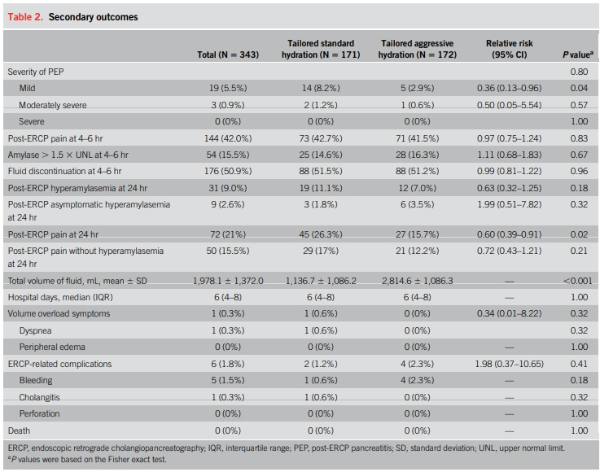

Slide 27
C) RESULTS
Subgroup analysis
- Among patients whose fluid was discontinued at 4–6 hours post-ERCP (Fluid-D group), none developed PEP. In the Fluid-D group, the incidence of post-ERCP hyperamylasemia, post-ERCP asymptomatic hyperamylasemia, post-ERCP pain, and post-ERCP pain without hyperamylasemia at 24 hours did not significantly differ between the TAH and TSH groups. In the Fluid-D group, the mean total volume of infused fluid was significantly greater in the TAH group than that in the TSH group (2,276.2±547.2 mL vs 443.36±133.1 mL, P < 0.001).

Slide 28
C) RESULTS
Subgroup analysis
- In patients who continued to receive fluid therapy after 4–6 hours (Fluid-C group), the incidence of PEP was considerably lower in the TAH group (7.1%, 95% CI 2.6%–15.5%; 6/84) than in the TSH group (19%, 95% CI 11.1%–31.3%; 16/83) with an RR of 0.37 (95% CI 0.15–0.90, P=0.02).
- The incidence rate of postERCP hyperamylasemia, post-ERCP asymptomatic hyperamylasemia, and post-ERCP pain without hyperamylasemia at 24 hours did not significantly differ between the 2 groups. Conversely, significantly fewer patients in the TAH group (27.4%, 95% CI 17.4%–41.1%; 23/84) had post-ERCP pain at 24 hours compared with those in the TSH group (47%, 95% CI 33.4%–64.2%; 39/83), demonstrating an RR of 0.58 (95% CI –0.38 to 0.88, P=0.01).
- Overall, in the fluid-C group, a greater total volume of fluid was administered in the TAH group than in the TSH group (3,378.6±1,219.9 mL vs 1,871.8±1,168.0 mL, P < 0.001).

Slide 29
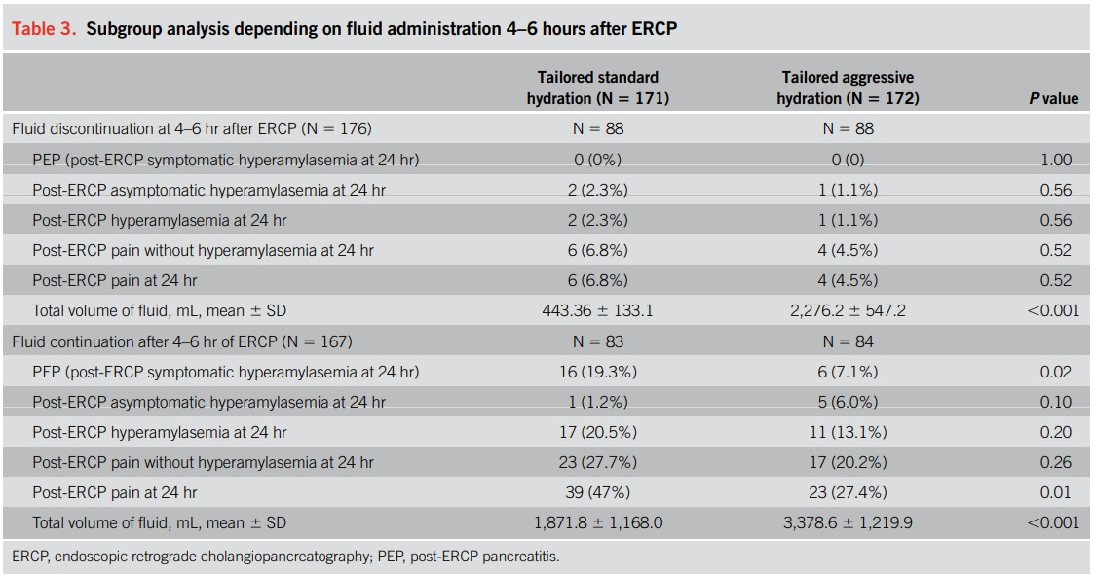

Slide 30
C) RESULTS
Subgroup analysis
- Subgroup analysis of the incidence of PEP stratified by the risk factors showed that among high risk-patients, PEP occurred less frequently in the TAH group than in the TSH group (4% vs 12.4%), revealing an RR of 0.32 (95% CI 0.11–0.98, P 5 0.03; Table 4).

Slide 31
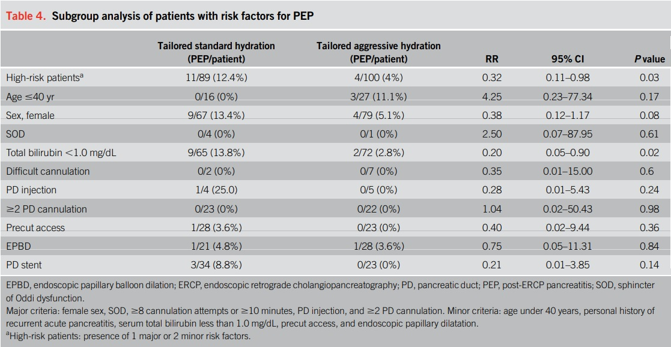

Slide 32
D) DISCUSSION
The incidence of PEP is reported to be 3.5%–9.7% in all patients and 8%–14.7% in high-risk patients (1,11). In our study, the overall incidence rate of PEP was 6.4% in all patients and 7.9% in high-risk patients, which concurs with the outcomes of previous studies. The incidence of PEP was 9.4% and 3.5% in the TSH and TAH groups, respectively, which generally adheres to the results of the former studies (12,13).
In our study, TAH significantly reduced the incidence of PEP compared with TSH in both ITT and PP analyses (3.5% vs 9.4%, P=0.03), which is consistent with previous findings comparing aggressive and standard hydration methods (12,14,15).

Slide 33
D) DISCUSSION
Aggressive intravenous hydration is 1 of 3 preventive measures for PEP suggested by European Society of Gastrointestinal Endoscopy and American Society for Gastrointestinal End.
The concept of using intravenous hydration as a prophylactic method for PEP has originated from treating acute pancreatitis. Early aggressive fluid resuscitation in acute pancreatitis has been considered beneficial for a long time (17).
However, in the recent Early Weight-Based Aggressive vs. Non-Aggressive Goal-Directed Fluid Resuscitation in the Early Phase of Acute Pancreatitis: An Open-Label Multicenter Randomized Controlled Trial (The WATERFALL trial) for the treatment of acute pancreatitis, aggressive hydration resulted in a higher incidence of fluid overload with no difference in the severity of pancreatitis compared with moderate hydration (18).

Slide 34
D) DISCUSSION
By contrast, our study showed that TAH is beneficial over TSH in reducing the risk of PEP without increasing the risk of fluid overload. The difference in these findings may be the result of when aggressive hydration was started: before or after the event of pancreatitis. After the event of acute pancreatitis, intra-abdominal pressure is increased and may be worsened by excessive hydration. However, patients undergoing ERCP often experience dehydration due to prolonged fasting. Providing early and aggressive hydration can help restore blood circulation and prevent pancreatic ischemia (19).
Enhanced hydration during the perioperative period can help avoid the vicious cycle of inflammation and microcirculation dysfunction in PEP by promoting pancreatic microcirculation (20).

Slide 35
D) DISCUSSION
Numerous studies have shown that aggressive perioperative hydration with LRS decreases the incidence of PEP (12,14–16).
Typically, the protocol involves a 20 mL/kg bolus, followed by 3 mL/kg/hr for 8 hours for aggressive hydration and 1.5 mL/kg/hr for 8 hours for standard hydration (12,14). On average, a 75-kg patient receives 3,300 mL for aggressive hydration and 900 mL for standard hydration (12,14). However, aggressive hydration therapy raises concerns about volume overload and prolonged fluid administration.

Slide 36
D) DISCUSSION
Our study aimed to streamline fluid therapy by reducing the time of treatment and volume of fluid administered. We used 2 predictors of PEP, namely early onset of abdominal pain and serum amylase elevation 4–6 hours after ERCP. To decrease the time and volume of fluid administered, we stopped hydration for patients with normal serum amylase and no abdominal pain.
In our study, hydration could be discontinued in approximately 50% of patients 4–6 hours after ERCP, notably earlier than the 8–24 hour period typically used in other studies (12,14,16).

Slide 37
D) DISCUSSION
In patients who discontinued fluid early 4–6 hours after ERCP, the mean volume of fluid administered was 2,276.2 ± 547.2 mL for the TAH group and 443.36 ± 133.1 mL for the TSH group, which is significantly less than 3,378.6 ± 1,219.9 mL and 1,871.8 ± 1,168.0 mL in patients who received prolonged aggressive and standard hydration modes, respectively (P < 0.001).
Using our study protocol, we calculated the average volume needed for a 75-kg patient. If hydration was stopped 4–6 hours post-ERCP, the volume needed for a 75-kg patient would be 2,400–2,850 mL in the TAH group and 450–675 mL in the TSH group. If hydration was continued 4–6 hours post-ERCP, the average volume required for a 75-kg patient would be 3,300 mL in the TAH group for 8 hours and 5,100–6,900 mL for 24 hours. In the TSH group, the volume would be 900 mL for 8 hours and 2,700–4,500 mL for 24 hours.

Slide 38
D) DISCUSSION
Our study suggests that selectively discontinuing fluid therapy in patients with a low probability of PEP can reduce both the volume and duration of hydration required.
To prevent PEP with tailored hydration, it is crucial to differentiate between high-probability patients and low-probability patients. Most post-ERCP adverse events occur within a few hours, allowing for early discharge of low-probability patients (5,6).

Slide 39
D) DISCUSSION
Many studies have shown that an early evaluation of serum amylase levels 4–6 hours after ERCP can predict the occurrence of PEP (21–23). Therefore, we used early occurrence of abdominal pain and serum amylase elevation as 2 predictors of PEP. The timing of assessment of these 2 predictors was 4 hours after ERCP in patients who did not receive pancreatic stenting and 6 hours after ERCP if pancreatic stenting was performed. The timing of assessment was different in accordance with a study by Kerdsirichairat et al, which reported that the onset of PEP was earlier without pancreatic stenting (24).
In this study, the onset of PEP was 5 hours (range 0–68 hours) with prophylactic pancreatic stenting and 2 hours (range 0.5–2.5 hours) without stenting (P < 0.05) (24).

Slide 40
D) DISCUSSION
The combination of rectal NSAIDs, pancreatic stenting, and aggressive hydration is often used for additive effects in preventing PEP. However, in the post-endoscopic retrograde cholangiopancreatography pancreatitis trial, it was observed that aggressive hydration did not reduce the incidence of PEP in patients with moderate-to-high risk of PEP if prophylactic rectal NSAIDs were routinely used (25). Conversely, in a recent study, rectal indomethacin alone did not effectively prevent PEP in high-risk patients compared with rectal indomethacin plus prophylactic pancreatic stenting (26).
In our study, a combination of tailored aggressive hydration and pancreatic stenting effectively prevented PEP. Not using NSAIDs allowed us to focus more on the impact of aggressive hydration in average-to-high risk patients. Therefore, more RCTs are needed to evaluate the additive effect of combining preventive methods for PEP in different patient risk categories.

Slide 41
D) DISCUSSION
some limitations:
- First, rectal NSAIDs were not used because they were not commercially available in Korea. Oral NSAIDswere not used in this study because previous studiesfailed to show prophylactic effect against PEP (27,28).
- Second, pancreatic stenting was left at the discretion of the endoscopists in our study. However, there was no statistically significant difference in the usage of pancreatic stenting between the TSH group and the TAH group (19.9% vs 13.4%, P=0.11). Furthermore, the incidence of PEP tended to be higher in the TSH group (8.8% vs 0%), which had a higher rate of pancreatic stenting, although this finding was also not statistically significant (P=0.14).
- Third, the treating physician and nursing staff were not blinded to the randomization allocation.

Slide 42
E) CONCLUSION
TAH with LRS, depending on the probability of PEP manifested by abdominal pain or elevated serum amylase levels 4–6 hours post-ERCP, is a safe and effective method for preventing PEP. A more personalized prevention method for patients undergoing ERCP may be possible with this hydration strategy.

Slide 43
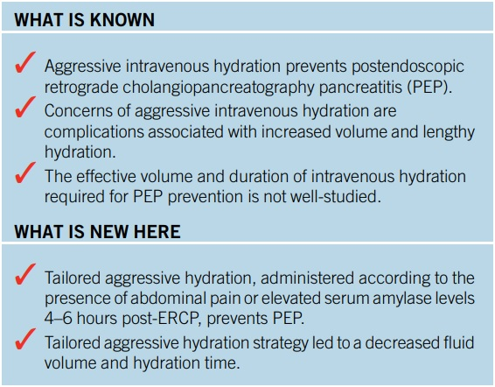
F) Study Highlights

Slide 44
Thanks
for
your Attention

